Slide 1
Module I – Introduction to Control System
Introduction to Control systems
Control System – Definition and Practical Examples
Classification of Control System : Open Loop and Closed Loop Systems – Definitions, Block diagrams, practical examples, and Comparison, Linear and Non-linear Control System, Time Varying and Time In-varying Systems
Servo System : Definition, Block Diagram, Classification (AC and DC Servo System), Block diagram of DC Servo System.
Laplace Transform and Transfer Function
Laplace Transform : Signifiance in Control System
Transfer Function : Definition, Derivation of transfer functions for Closed loop Control System and Open Loop Control System, Differential Equations and transfer functions of RC and RLC Circuit
Block Diagram Algebra
Order of a System : Definition, 0,1,2 order system Standard equation, Practical Examples
Block Diagram Reduction Technique: Need, Reduction Rules, Problems

Slide 2
Need of Block Diagram Algebra
If the system is simple & has limited parameters then it
is easy to analyze such systems using the methods discussed earlier i.e. transfer function, if the system is complicated and also have number of parameters then it is very difficult to analyze it.

Slide 3
Need of Block Diagram Algebra
To overcome this problem representation method is used.
block
diagram
It is a simple way to represent any practically complicated system. In this each component of the system is represented by a separate block known as functional block.
These blocks are interconnected in a proper sequence.

Slide 4
Block Diagram Fundamentals
Block Diagram: It is shorthand, pictorial representation
of the cause and effect relationship between input and output of a physical system.
BLOCK
Input
Output

Slide 5
Block Diagram Fundamentals
Output: The value of the input is multiplied to the value of block gain to get the output.
3s
X(s)
Y(s)
Output
Y(s)= 3s. X(s)

Slide 6
Block Diagram Fundamentals
Summing Point: Two or more signals can be added/ substracted at summing point.
y
+
x
output
+
Output =x+y-z
-
z

Slide 7
Block Diagram Fundamentals
Take off Point: The output signal can be applied to two or more points from a take off point.
Z
Z
Z
Take off point
Z
103

Slide 8
Block Diagram Fundamentals
Forward Path: The direction of flow of signal is from input to output
Forward Path
R(s) +
C(s)
G1
G2
-
H1
Feedback Path
Feedback Path: The direction of flow of signal is from output to input

Slide 9
Block Diagram Reduction Techniques
Rule 1: For blocks in cascade
Gain of blocks connected in cascade gets multiplied with each other.
R(s)
R1(s) _{G2}
C(s)
R(s)
G1G2
C(s)
G1
R1(s)=G1R(s)
C(s)= G1G2R(s)
C(s) =G2R1(s)
=G1G2R(s)

Slide 10
R(s)
G1
G2
G3
C(s)
Find Equivalent
R(s)
G1G2G3
C(s)

Slide 11
R(s)
G1
G2
G3
C(s)
R1(s)
Find Equivalent
R(s)
C(s)
R(s)
G1G2
G3
C(s)
G1G2G3
R1(s)
107

Slide 12
Block Diagram Reduction Techniques
Rule 2: For blocks in Parallel
Gain of blocks connected in parallel gets added algebraically.
G1
R1(s)
+
R(s)
R(s)
G2
R2(s) ⁻
C(s)
G1-G2+G3
C(s)
+
G3
R3(s)
C(s)= R1(s)-R2(s)+R3(s)
= G1R(s)-G2R(s)+G3R(s)
C(s)=(G1-G2+G3) R(s)
C(s)= (G1-G2+G3) R(s)

Slide 13
Block Diagram Reduction Techniques
Rule 3: Eliminate Feedback Loop
R(s)
+
C(s)
E(s)
G
₊-
R(s)
G
1 ± GH
C(s)
B(s)
H
C(s)
G
=
In General
R(s)
1 ± GH

Slide 14
From Shown Figure,
E(s) = R(s) − B(s)
C(s) = G.E(s)
= G[R(s) − B(s)]
= GR(s) − GB(s)
and
R(s)
C(s)
+₋
E(s)
G
But
B(s)
H
B(s) = H.C(s)
∴C(s) = G.R(s) − G.H.C(s)
C(s) + G.H = GR(s)
∴C(s){1+ G.H} = G.R(s)
∴ C(s) ₌ G R(s) 1 + GH
For Negative Feedback

Slide 15
From Shown Figure,
E(s) = R(s) + B(s)
and
C(s) = G.E(s)
= G[R(s) + B(s)]
= GR(s) + GB(s)
B(s) = H.C(s)
∴C(s) = G.R(s) + G.H.C(s)
R(s)
C(s)
+₊
E(s)
G
But
B(s)
H
C(s) − G.H = GR(s)
∴C(s){1− G.H} = G.R(s)
∴ C(s) ₌ G R(s) 1 − GH
For Positive Feedback
111

Slide 16
Block Diagram Reduction Techniques
Rule 4: Associative Law for Summing Points
The order of summing points can be changed if two or more summing points are in series
R(s) ⁺
_{X} +
C(s)
R(s) +
_{X} +
C(s)
-
-
B2
X=R(s)-B2
B1
X=R(s)-B1
C(s)=X-B2
B2
B1
C(s)=X-B1 C(s)=R(s)-B2-B1
C(s)=R(s)-B1-B2

Slide 17
Block Diagram Reduction Techniques
Rule 5: Shift summing point before block
R(s)
G
+
C(s)
R(s) +
C(s)
G
+
+
X
1/G
X
C(s)=R(s)G+X
C(s)=G{R(s)+X/G}
=GR(s)+X

Slide 18
Block Diagram Reduction Techniques
Rule 6: Shift summing point after block
R(s) +
G
C(s)
R(s)
G
+
C(s)
+
+
G
X
X
C(s)=G{R(s)+X}
=GR(s)+GX
C(s)=GR(s)+XG
=GR(s)+XG

Slide 19
Block Diagram Reduction Techniques
Rule 7: Shift a take off point before block
R(s)
G
C(s)
R(s)
G
C(s)
G
X
X
C(s)=GR(s)
and X=C(s)=GR(s)
C(s)=GR(s)
and X=GR(s)

Slide 20
Block Diagram Reduction Techniques
Rule 8: Shift a take off point after block
R(s)
G
C(s)
R(s)
G
C(s)
1/G
X
X
C(s)=GR(s)
and X=C(s).{1/G}
=GR(s).{1/G}
= R(s)
C(s)=GR(s)
and X=R(s)
116

Slide 21
Block Diagram Reduction Techniques
While solving block diagram for getting single block
equivalent, the said rules need to be applied. After each simplification a decision needs to be taken. For each decision we suggest preferences as

Slide 22
Block Diagram Reduction Techniques
First Choice
First Preference:
Rule 1 (For series)
Second Preference:
Rule 2 (For parallel)
Third Preference:
Rule 3 (For FB loop)

Slide 23
Block Diagram Reduction Techniques
Second Choice
(Equal Preference)
Rule 4 Adjusting summing order
Rule 5/6 Shifting summing point before/after block Rule7/8 Shifting take off point before/after block

Slide 24
Example 1
G4
+
R(s) ⁺
+
G1
G2
G3
+
C(s)
G6
-
-
+
H1
G5
H2

Slide 25
Rule 1 cannot be used as there are no immediate series blocks.
Hence Rule 2 can be applied to G4, G3, G5 in parallel to get an equivalent of G3+G4+G5

Slide 26
Example 1
cont….
Apply Rule 2
Blocks in Parallel
G4
+
R(s) ⁺
+
G1
G2
G3
+
C(s)
G6
-
-
+
H1
G5
H2

Slide 27
Example 1
cont….
Apply Rule 1
Blocks in series
R(s) +
+
G1
G2
C(s)
G3+G4+G5
G6
-
-
H1
H2

Slide 28
Example 1
cont….
Apply Rule 3
Elimination of feedback loop
R(s)
+
+
G1
C(s)
G2(G3+G4+G5)
G6
-
-
H1
H2

Slide 29
Example 1
cont….
Apply Rule 1
Blocks in series
G1
1 + G1H1
R(s) +
C(s)
G2(G3+G4+G5)
G6
-
H2

Slide 30
Example 1
cont….
Apply Rule 3
Elimination of feedback loop
G1G2(G 3 + G 4 + G 5) 1 + G1H1
R(s) ⁺
G6
C(s)
-
H2

Slide 31
Example 1
cont….
Apply Rule 1
Blocks in series
G1G2(G 3 + G 4 + G 5)
1 + G1H1 + G1G2H 2(G 3 + G 4 + G 5)
C(s)
R(s)
G6

Slide 32
Example 1
cont….
G1G2G6(G 3 + G 4 + G 5)
1 + G1H1 + G1G2H 2(G 3 + G 4 + G 5)
R(s)
C(s)

Slide 33
Example 1
cont….
C (s) ₌
G1G2G6(G 3 + G 4 + G 5)
R(s)
1 + G1H1 + G1G2H 2(G 3 + G 4 + G 5)

Slide 34
Example 2
G4
+
R(s) +
+
G1
G2
G3
+
C(s)
+
-
H1
H2

Slide 35
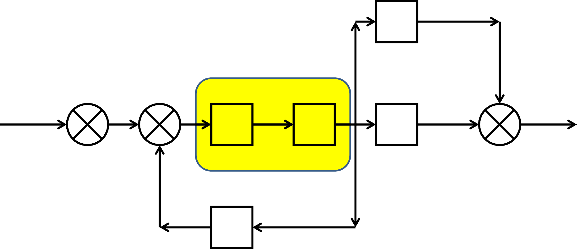
Example 2
cont….
Apply Rule 1 Blocks in series
G4
+
R(s) +
+
+
C(s)
G1
G2
G3
+
-
H1
H2

Slide 36
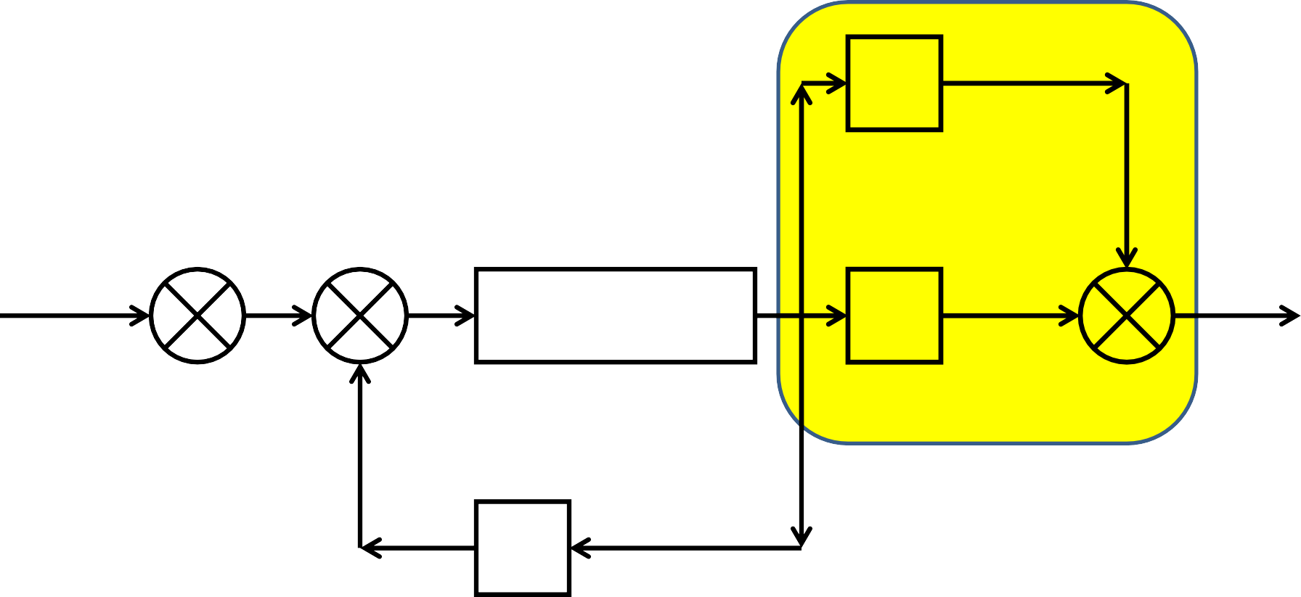
Example 2
cont….
Apply Rule 2 Blocks in parallel
G4
+
R(s) +
+
+
C(s)
G1G2
G3
+
-
H1
H2

Slide 37
Example 2
cont….
Apply Rule 3
Elimination of feedback loop
R(s) +
+
G1G2
G3+G4
C(s)
+
-
H1
H2

Slide 38
Example 2
cont….
Apply Rule 2
Blocks in series
G1G2
1 + G1G2H1
R(s) +
G3+G4
C(s)
+
H2

Slide 39
Example 2
cont….
Apply Rule 3
Elimination of feedback loop
G1G2(G 3 + G 4) 1 + G1G2H1
R(s) +
C(s)
+
H2

Slide 40
Example 2
cont….
G1G2(G 3 + G 4)
1 + G1G2H1 − G1G2G3H 2 − G1G2G4H 2
R(s)
C(s)

Slide 41
Example 2
cont….
C(s) ₌
G1G2(G 3 + G 4)
R(s)
1 + G1G2H1 − G1G2G3H 2 − G1G2G4H 2

Slide 42
Example 3
G5
+
R(s) +
G1
+
G2
G3
+
G4
C(s)
-
-
H1
H2

Slide 43
Example 3
cont….
Apply Rule 3
Elimination of feedback loop
G5
+
R(s) +
G1
+
G2
G3
+
G4
C(s)
-
-
H1
H2

Slide 44
Example 3
cont….
Apply Rule 1
Blocks in series
G5
+
G2
1 + G2H1
R(s) +
G1
G3
+
G4
C(s)
-
H2

Slide 45
Example 3
cont….
Apply Rule 2
Blocks in parallel
G5
+
G1G2G3 1 + G2H1
R(s) +
+
G4
C(s)
-
H2

Slide 46
Example 3
cont….
Apply Rule 1 Blocks in series
_{G5 +} G1G2G3
R(s) +
G4
C(s)
1 + G2H1
-
H2

Slide 47
Example 3
cont….
Apply Rule 3
Elimination of feedback loop
R(s) +
C(s)
G 4(G5 + ^{G1G2G3} )
1 + G2H1
-
H2

Slide 48
Example 3
cont….
G4G5 + G2G4G5H1 + G1G2G3G4
1+ G2H1+ G4G5H 2 + G2G4G5H1H 2 + G1G2G3G4H 2
R(s)
C(s)

Slide 49
Example 3
cont….
C(s) ₌
G4G5 + G2G4G5H1 + G1G2G3G4
R(s)
1 + G2H1 + G4G5H 2 + G2G4G5H1H 2 + G1G2G3G4H 2

Slide 50
Example 4
R(s) +
+
-
+
C(s)
G1
G2
-
-
H1
H2

Slide 51
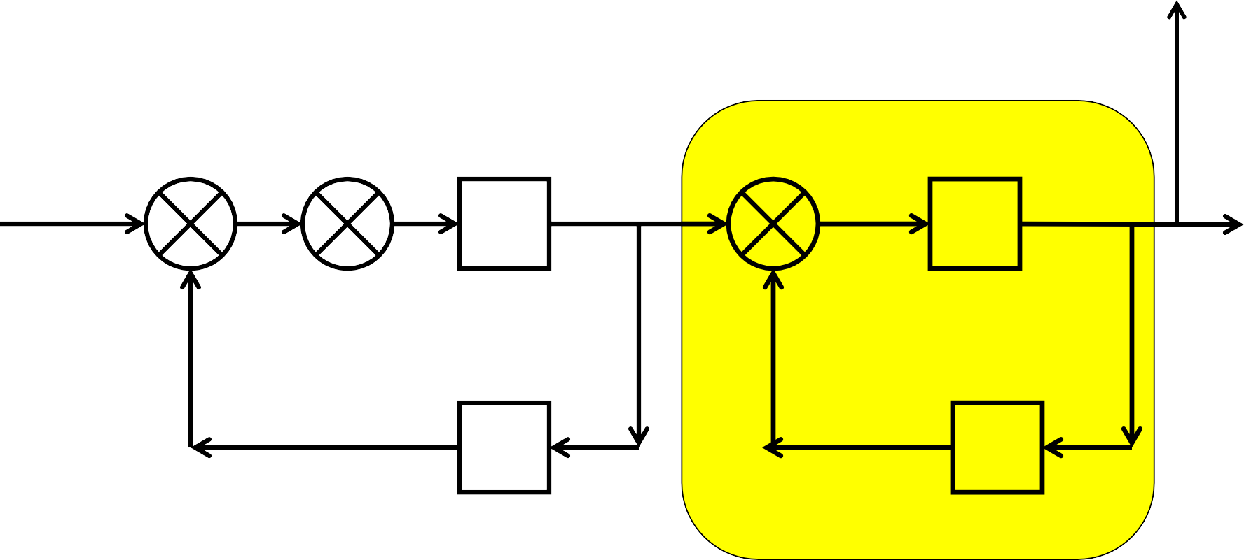
Example 4
cont….
Apply Rule 3
Elimination of feedback loop
-
R(s) +
+
+
C(s)
G1
G2
-
-
H1
H2

Slide 52
Example 4
cont….
G2
1 + G2H 2
R(s) +
+
-
C(s)
G1
-
H1

Slide 53
Now Rule 1, 2 or 3 cannot be used directly.
There are possible ways of going ahead.
Use Rule 4 & interchange order of summing so that Rule 3 can be used on G.H1 loop.
b. Shift take off point after
G2
block reduce
1 + G2H 2
by Rule 1, followed by Rule 3.
Which option we have to use????

Slide 54
Example 4
cont….
Apply Rule 4
Exchange summing order
1
R(s) +
2
G2
1 + G2H 2
+
-
C(s)
G1
-
H1

Slide 55
Example 4
cont….
Apply Rule 3 Elimination feedback loop
1
G2
1 + G2H 2
2
R(s) +
-
+
G1
C(s)
-
H1

Slide 56
Example 4
cont….
Apply Rule 1 Bocks in series
G1
1 + G1H1
G2
1 + G2H 2
2
R(s) +
-
C(s)

Slide 57
Example 4
cont….
G1G2
1 + G1H1 + G2H 2 + G1G2H1H 2
2
R(s) +
-
C(s)
Now which Rule will be applied
-------It is blocks in parallel
-------It is feed back loop
OR

Slide 58
Example 4
cont….
Let us rearrange the block diagram to understand Apply Rule 3 Elimination of feed back loop
G1G2
1 + G1H1 + G2H 2 + G1G2H1H 2
2
R(s) +
C(s)
-

Slide 59
Example 4
cont….
G1G2
1 + G1H1 + G2H 2 + G1G2H1H 2 + G1G2
R(s)
C(s)

Slide 60
Example 4
cont….
C(s) ₌
G1G2
R(s)
1 + G1H1 + G2H 2 + G1G2H1H 2 + G1G2

Slide 61
Note 1: According to Rule 4
By corollary, one can split a summing point to two summing point and sum in any order
B
B
+
R(s) +
G
C(s)
+
+ ₊
R(s)
G
C(s)
-
-
H
H

Slide 62
Example 5
Simplify, by splitting second summing point as
said in note 1
H1
-
R(s) +
+
G1
G2
G3
C(s)
-
-
H2
H3

Slide 63
Example 5
cont….
Apply rule 3
Elimination of feedback loop
H1
+
+
+
-
C(s)
G1
G2
G3
R(s)
-
-
H2
H3

Slide 64
Example 5
cont….
Apply rule 1
Blocks in series
+
G1
1 + G1H1
+
G2
G3
C(s)
R(s)
-
-
H2
H3

Slide 65
Example 5
cont….
Apply rule 3
Elimination of feedback loop
G1G2
1 + G1H1
+
+
G3
R(s)
-
C(s)
-
H2
H3

Slide 66
Example 5
cont….
Apply rule 1
Blocks in series
G1G2
1 + G1H1 + G1G2H 2
+
G3
C(s)
R(s)
-
H3

Slide 67
Example 5
cont….
Apply rule 3
Elimination of feedback loop
G1G2G3
1 + G1H1 + G1G2H 2
+
R(s)
C(s)
-
H3

Slide 68
Example 5
cont….
G1G2G3
1 + G1H1 + G1G2H 2 + G1G2G3H 3
R(s)
C(s)

Slide 69
Example 5
cont….
C(s) ₌
G1G2G3
R(s)
1 + G1H1 + G1G2H 2 + G1G2G3H 3

Slide 70

Example 6
Apply rule 8
Shift take off point beyond block G3
G5
+
R(s) +
G1
+
G2
G3
G4
+
C(s)
-
-
H1
H2

Slide 71
Example 6
cont….
Apply rule 1 Blocks in series
1/ G3
G5
+
R(s) +
G1
+
G2
G3
G4
+
C(s)
-
-
H1
H2

Slide 72
Example 6
cont….
Apply rule 2 Blocks in parallel
G5/ G3
+
R(s) +
G1
+
G2G3
G4
+
C(s)
-
-
H1
H2

Slide 73
Example 6
cont….
Apply rule 3 Feedback loop
G4+(G5/
G3)
R(s) +
G1
+
G2G3
C(s)
-
-
H1
H2

Slide 74
Example 6
cont….
Apply rule 1 Blocks in series
G4+(G5/
G3)
R(s) +
G1
G2G3
C(s)
1+ G2G3H1
-
H2

Slide 75
Example 6
cont….
R(s) +
G2G3
C(s)
(G1)(
)(G 4 + ^{G5})
1+ G2G3H1
G3
-
H2

Slide 76
Example 6
cont….
G2G3
= (G1)(
)(G 4 + ^{G5})
1+ G2G3H1
G3
G2G3
₎₍G 4G3 + G5₎
= (G1)(
1+ G2G3H1 G3
₌ G1G2(G 4 G 3 + G 5) 1 + G2G3H1

Slide 77
Example 6
cont….
Apply rule 3
Feedback loop
G1G2(G 4 G 3 + G 5) 1 + G2G3H1
R(s) +
C(s)
-
H2

Slide 78
Example 6
cont….
 | G1G2(G 4 G 3 + G 5)
1 + G2G3H1 + G1G2H 2(G 3G 4 + G 5)
C(s)
R(s)

Slide 79
Example 6
cont….
C(S) ₌
G1G2(G 4 G 3 + G 5)
R(S)
1 + G2G3H1 + G1G2H 2(G 3G 4 + G 5)

Slide 80
Example 7
Apply rule 8
Shift take off point after block G4
H2
-
R(s) +
G1
+
G2
+
G3
G4
-
-
C(s)
H3
H1

Slide 81
Example 7
cont….
Apply rule 1
Blocks in series
H2
1/G4
-
R(s) +
G1
+
G2
+
G3
G4
-
-
C(s)
H3
H1

Slide 82
Example 7
cont….
Apply rule 3
Feedback loop
H2/
G4
-
R(s) +
G1
+
G2
+
G3G4
-
-
C(s)
H3
H1

Slide 83
Example 7
cont….
Apply rule 1
Blocks in series
H2/
G4
-
R(s) +
+
G3G4
1 + G3G4H 3
G1
G2
-
C(s)
H1

Slide 84
Example 7
cont….
Apply rule 3
Feedback loop
H2/ G4
-
G2G3G4 1 + G3G4H 3
R(s) +
G1
+
-
C(s)
H1

Slide 85
Example 7
cont….
Apply rule 1
Blocks in series
G2G3G4
1 + G3G4H 3 + G2G3H 2
R(s) +
C(s)
G1
-
H1

Slide 86
Example 7
cont….
Apply rule 3
Feedback loop
G1G2G3G4
1 + G3G4H 3 + G2G3H 2
R(s) +
C(s)
-
H1

Slide 87
Example 7
cont….
G1G2G3G4
1 + G3G4H 3 + G2G3H 2 + G1G2G3G4H1
R(s)
C(s)

Slide 88
Example 7
cont….
C(S) ₌
G1G2G3G4
R(S)
1 + G3G4H 3 + G2G3H 2 + G1G2G3G4H1

Slide 89
Example 8
Simplify, by splitting 3rd summing point as given in Note 1
G3
3
1
R(s) +
2
+
+
G1
G2
+
G4
C(s)
- -
-
H2
H1

Slide 90
Example 8
cont….
Apply Rule 3
Elimination of Feedback loop
G3
+ ₊
R(s) +
+
G1
G2
+
G4
C(s)
- -
-
H2
H1

Slide 91
Example 8
cont….
Apply Rule 8
Shift take off point after block
G3
+
G4 1 + G4H1
R(s) +
+
G1
+
C(s)
G2
- -
H2

Slide 92
Example 8
cont….
Apply Rule 1 Blocks in series
G3/
G2
+
G4 1 + G4H1
R(s) +
+
G1
G2
+
C(s)
- -
H2

Slide 93
Example 8
cont….
Now which rule we have to use?
G3/
G2
+
G4 1 + G4H1
R(s) +
+
G1G2
+
C(s)
- -
H2

Slide 94
Example 8
cont….
Apply Rule 2 Blocks in parallel
G3/
G2
+
G4 1 + G4H1
R(s) +
+
G1G2
1
+
C(s)
- -
H2

Slide 95
Example 8
cont….
Apply Rule 1
Blocks in series
G3 ₊ ₁
G2
G4 1 + G4H1
R(s) +
+
G1G2
C(s)
- -
H2

Slide 96
Example 8
cont….
Apply Rule 3
Elimination of Feedback Loop
(G 3 + G 2)G4 G 2(1 + G4H1)
R(s) +
+
G1G2
C(s)
- -
H2

Slide 97
Example 8
cont….
Apply Rule 1
Blocks in series
G1G2
1 + G1G2H 2
(G 3 + G 2)G4 G 2(1 + G4H1)
R(s) +
C(s)
-

Slide 98
Example 8
cont….
Apply Rule 3
Elimination of Feedback loop
G1G4(G 3 + G 2)
(1 + G1G 2 H 2)(1 + G4H1)
R(s) +
C(s)
-

Slide 99
Example 8
cont….
G1G4(G 3 + G 2)
1+ G 4 H1+ G1G2H 2 + G1G2G4H1H 2 + G1G4(G 2 + G 3)
R(s)
C(s)

Slide 100
Example 8
cont….
C(s) ₌
G1G4(G 3 + G 2)
R(s)
1 + G 4 H1 + G1G2H 2 + G1G2G4H1H 2 + G1G4(G 2 + G 3)

Slide 101
Example 9
Apply rule 2
Blocks in Parallel
G4
+
R(s) +
G1
+
+ -
G2
+
G3
C(s)
-
-
G5
H1
H2
H3

Slide 102
Example 9
cont….
Apply rule 3
Elimination of Feedback Loop
R(s) +
G1+G4+ G5
+
G2
+
G3
-
-
-
C(s)
H1
H2
H3

Slide 103
Example 9
cont….
Apply rule 1
Blocks in Series
G2
1 + G2H1
G3
1 + G3H 2
R(s) +
G1+G4+G5
C(s)
-
H3

Slide 104
Example 9
cont….
Apply rule 3
Elimination of Feedback loop
G2G3(G1 + G 4 + G 5) (1 + G2H1)(1 + G 3 H 2)
R(s) +
C(s)
-
H3

Slide 105
Example 9
cont….
G2G3(G1 + G 4 + G 5)
1 + G2H1 + G3H 2 + G2G3H1H 2 + G2G3H 3(G1 + G 4 + G 5)
R(s)
C(s)

Slide 106
Example 9
cont….
C(s) ₌ G2G3(G1 + G 4 + G 5)
R(s) 1 + G2H1 + G3H 2 + G2G3H1H 2 + G2G3H 3(G1 + G 4 + G 5)

Slide 107
Example 10
Apply rule 2
Blocks in Parallel
R(s)
+
G2
G3
+
G1
-
-
-
C(s)
+
H1
H3
+

Slide 108
Example 10
cont….
Apply rule 3
Elimination of Feedback Loop
R(s)
+
G2
1+G3
G1
-
-
C(s)
+
H1
H3
+

Slide 109
Example 10
cont….
Apply rule 8
Shift take off point after block
G2
1 + G2
R(s)
+
G1
1+G3
-
-
C(s)
+
H1
H3
+

Slide 110
Example 10
cont….
Apply rule 1
Blocks in series
G2
1 + G2
R(s)
+
1+G3
G1
-
-
C(s)
1
1 + G3
+
H1
H3
+

Slide 111
Example 10
cont….
Apply rule 2
Blocks in Parallel
G2(1 + G 3) 1 + G2
R(s)
+
G1
-
-
C(s)
1
1 + G3
+
H1
H3
+

Slide 112
Example 10
cont….
Apply rule 1
Blocks in Series
G2(1 + G 3) 1 + G2
R(s)
+
G1
-
-
C(s)
1
1 + G3
H1
H 2 +

Slide 113
Example 10
cont….
Apply rule 3
Elimination of Feedback loop
G2(1 + G 3) 1 + G2
R(s)
G1
+
-
-
C(s)
H1(H 2 + H 2 G 3 + 1) 1 + G3

Slide 114
Example 10
cont….
Apply rule 1
Blocks in series
G2(1 + G 3)
1 + G2 + G2H1(1 + H 2 + H 2 G 3)
R(s)
G1
C(s)

Slide 115
Example 10
cont….
R(s)
G1G2(1 + G 3)
1 + G2 + G2H1(1 + H 2 + H 2 G 3)
C(s)

Slide 116
Example 10
cont….
C(s) ₌
G1G2(1 + G 3)
R(s)
1 + G2 + G2H1(1 + H 2 + H 2 G 3)

Slide 117

References
Control System Engineering
J. J. Nagrath, M. Gopal
Feedback Control System
R. A. Barapate
Modern Engineering
Control
- K. Ogata
117

Slide 118

Online Tutorials
http://www.electrical4u.com
/control-engineering- historical-review-and-types- of-control-engineering/
http://www.academia.edu/6 729369/EC2255-
_Control_System_Notes_solv ed_problems_
6/30/2016
Amit Nevase
118

Slide 119
Thank You
119

